Slide 1
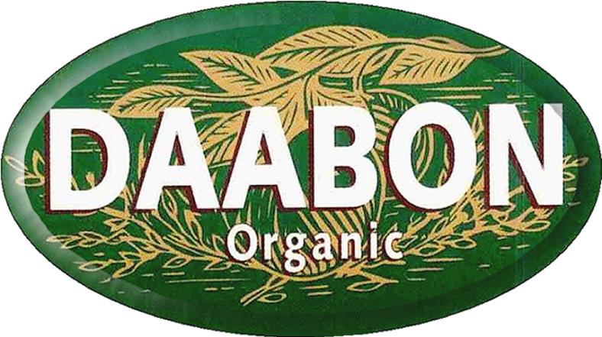
From the Soil to the Market
Sustainable Palm Oil

Slide 2
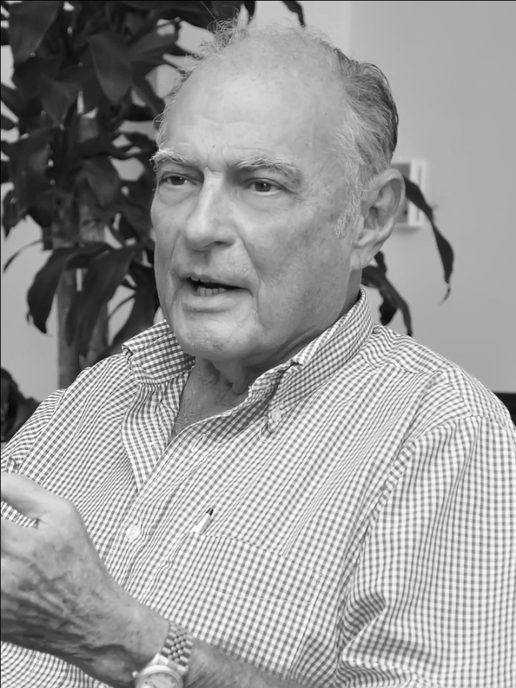
Historical background
The DAABON Group is a family driven company that initiated operations back in 1914.
In the late 1970´s Mr. Davila began diminishing the amount of pesticides that where recommended by professionals at that time
The Davila Abondano family decided to switch to organic agriculture. It has been the core operation ever since.
Mr. ALBERTO DAVILA DIAZGRANADOS
Corporate President
DAABON

Slide 3



DAABON Group in brief
The DAABON Holding is conformed by six companies, all related to production, transformation, storage and export of agricultural products:
C.I. Tequendama S.A.S: Palm Oil Operations,
C.I. La Samaria S.A.S.: Bananas and De-hydrated produce,
ECOBIO COLOMBIA Ltda.: Coffee and Cocoa harvest,
TERLICA S.A.: Liquid Bulk Terminal
Caribbean EcoSoaps: Soap and Glycerine production
Zona Franca Las Americas, LatAm´s first sustainable Export Processing Zone EPZ

Slide 4
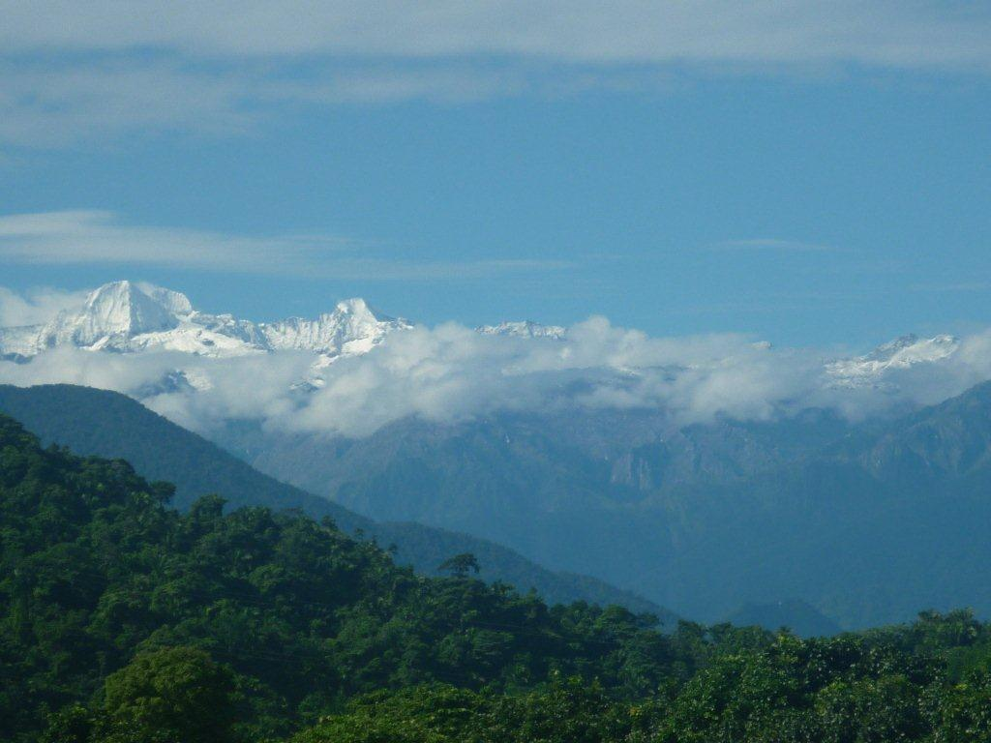
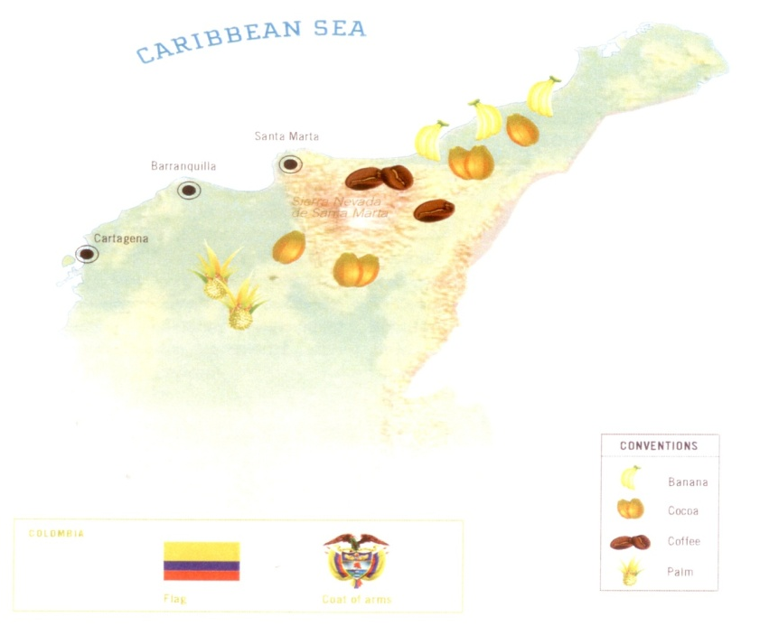
Geographic and regional context
The DAABON Headquarters are located in Santa Marta; the northernmost region of the Colombian Caribbean.

Slide 5
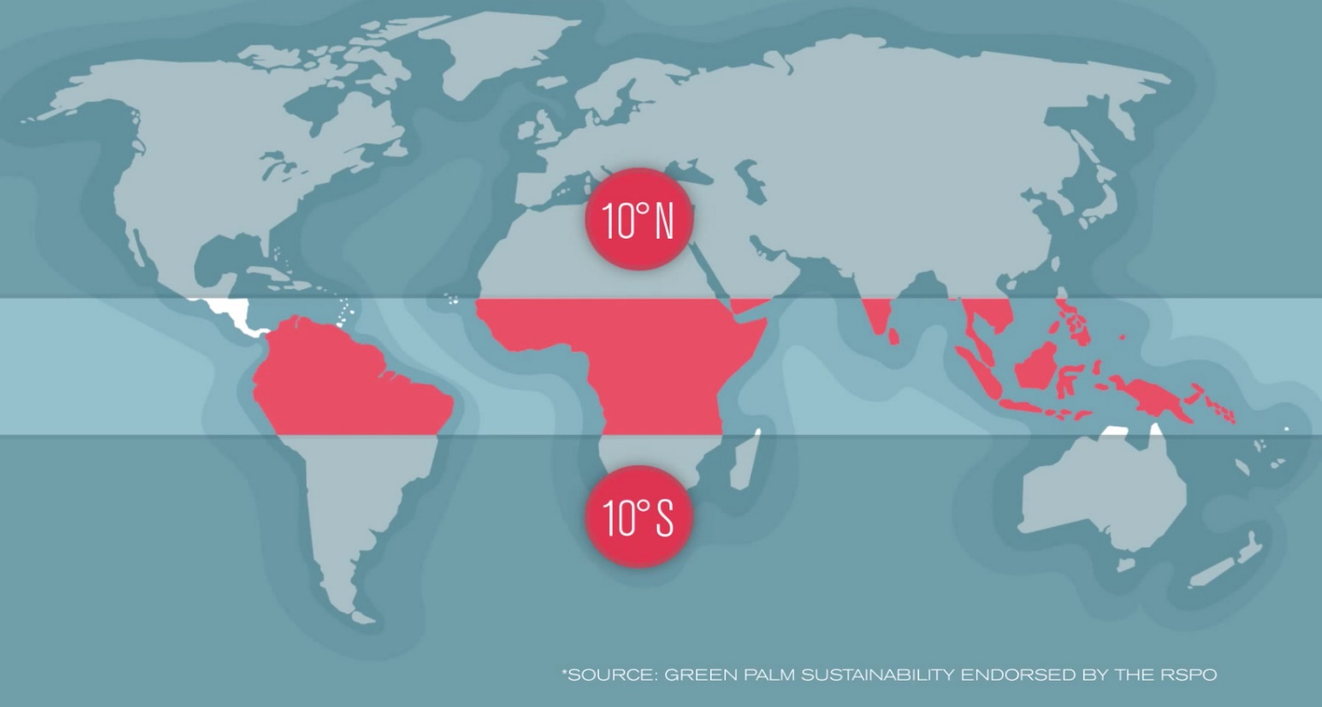
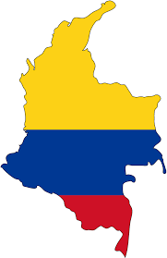
Strategic Location
Biodiversity Hotspots
Colombia’s story
Indigenous Populations

Slide 6
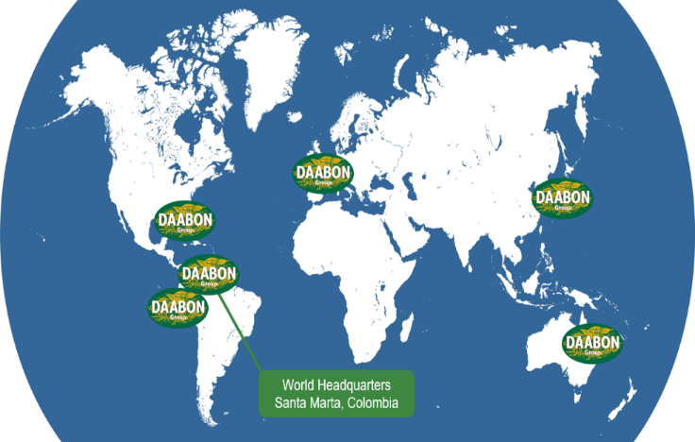
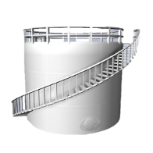

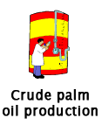

“Commercial offices all over the world”
Storage
Transportation
100% direct traceability to the farm.

Slide 7

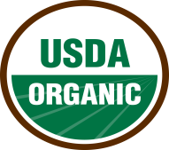
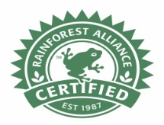
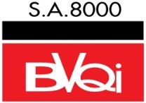
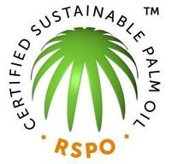


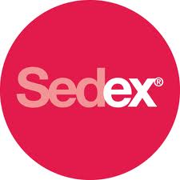







External Verifications

Slide 8
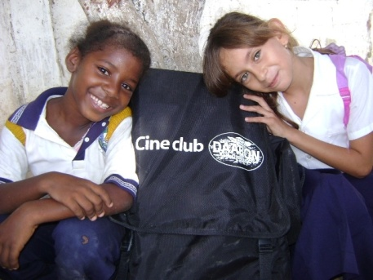
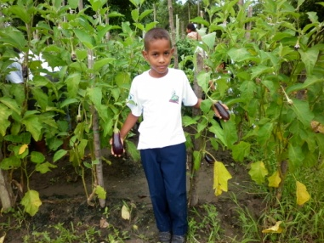
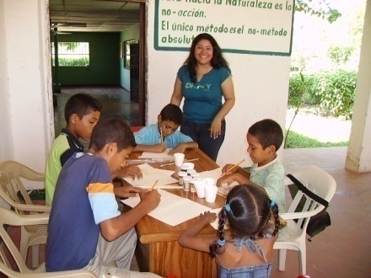
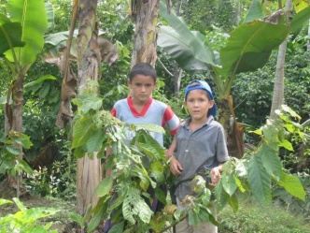
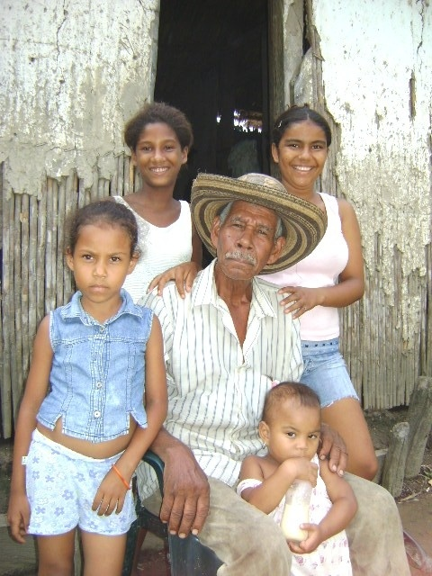
Social context
The DAABON production sites are surrounded by an array of farmer communities.
These communities have been negatively influenced in the past.

Slide 9


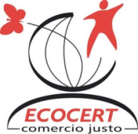








The DAABON Sustainability Policy
Promote environmental protection and human development as a fundamental pillar of our corporate mission and company vision; with means to achieve optimum levels of social development, leadership and competitiveness; embarked in an economically viable, environmentally sustainable and socially fair productive system

Slide 10
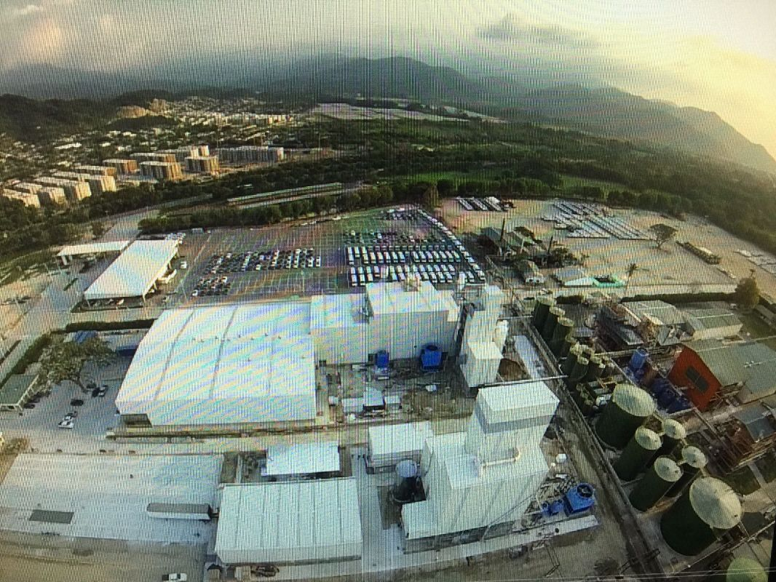

Palm Oil Production Process
Refining & Production Capacity
fff
Palm oil refinery capacity (41,000 MT) per month.
Four refineries in total– provides flexibility to meet
high volume needs as well as small, customized requirements.
HACCP and SQF Level 2

Slide 11
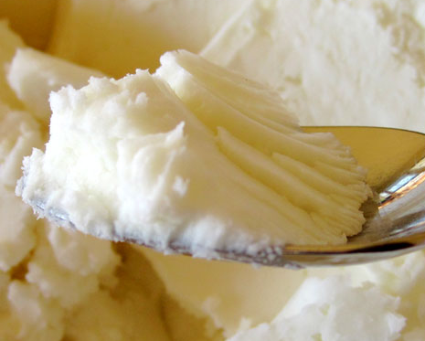
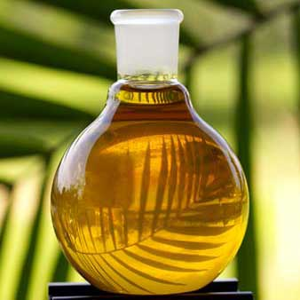
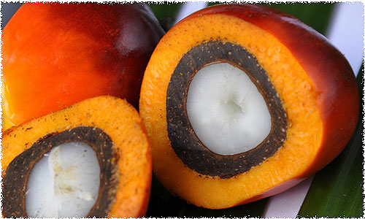

Product Offerings
Refined (RBD) palm fruit and palm kernel oils
Palm shortenings
Fractionated products (liquid olein for frying and solid stearins)
Blends (ex. palm mixed with soy, sunflower, canola)
Custom products based on client requirements
Natural and certified organic offerings

Slide 12
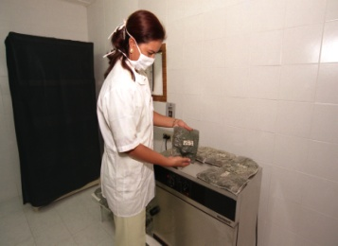
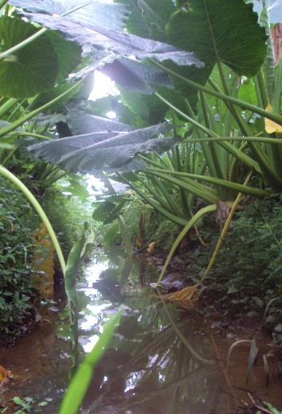
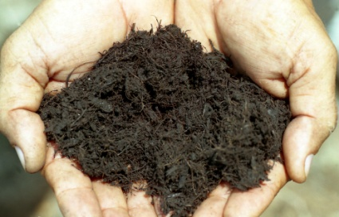
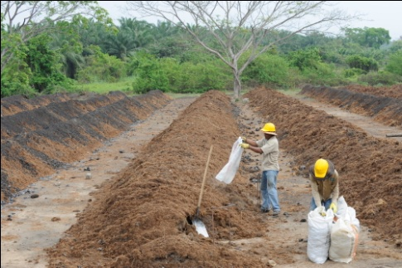
Agroecological management
First company in Colombia to develop an organic palm oil process
Efficient and rational water usage program
Soil preservation practices
Areas for biodiversity enhancement and shelter
Nutrient cycling
Integrated pest control management

Slide 13
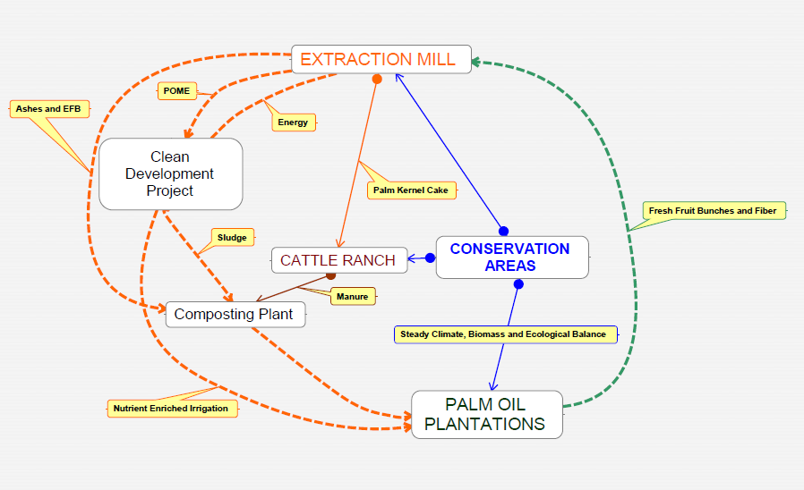
Cycling and Life Cycle Assessment

Slide 14
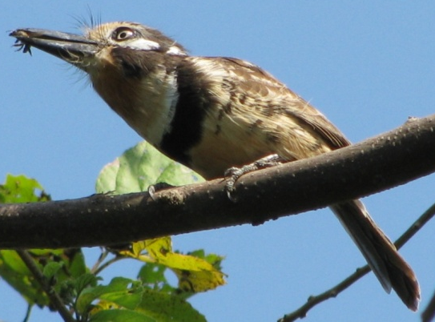
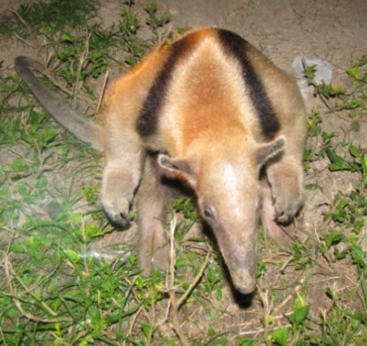
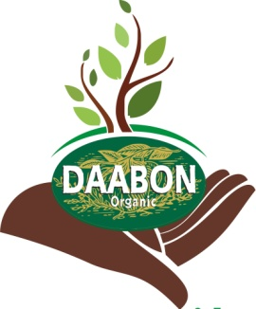
Environmental management plan
The EMP´s are custom designed by the Sustainability Department.
Comprehensive biodiversity inventories
Plume and/or dust control

Slide 15
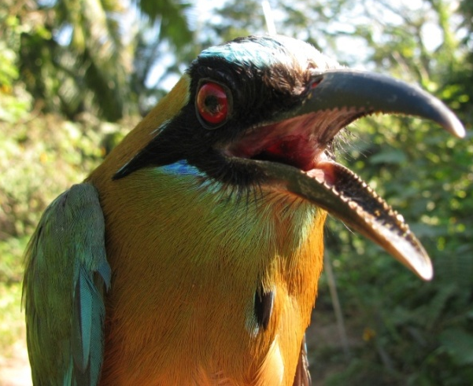
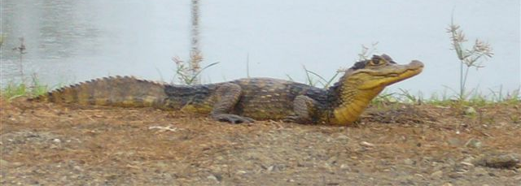
Environmental management plan
Effluent monitoring
Solid waste management
Reforestation, regeneration and conservation

Slide 16
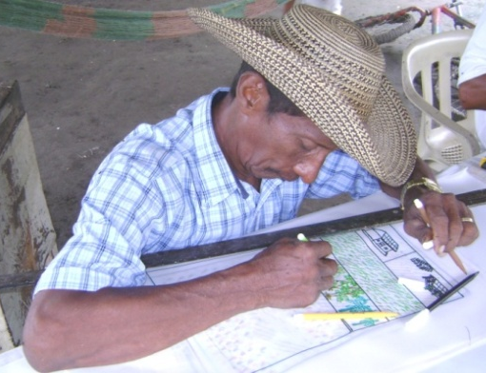

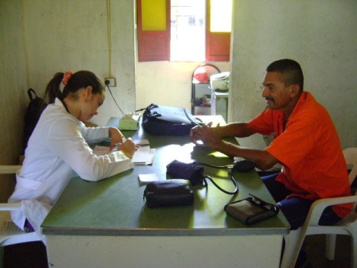
Social management plan
1500 workplaces and 200 farmer families
The Tequendama employees are part of the surrounding communities and are permanent to the company payroll. We do not hire seasonal or temporary workers.
The company guarantees the right of association for workers
Programs such as micro enterprising and the “Education for Productive Employment” program.

Slide 17
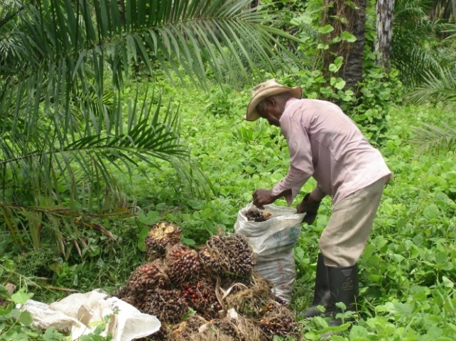
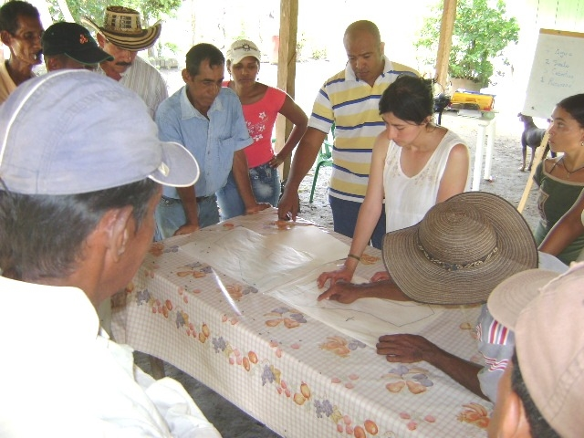
Productive alliances program
Joint agricultural processes that enable smallholder inclusion into a robust supply chain.
This model was initially proposed as a government program.

Slide 18
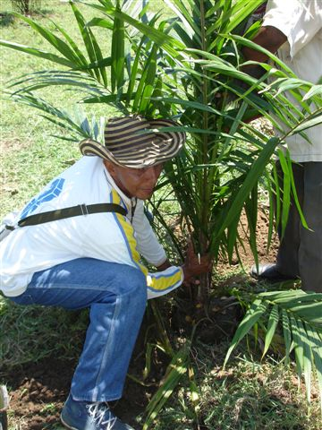
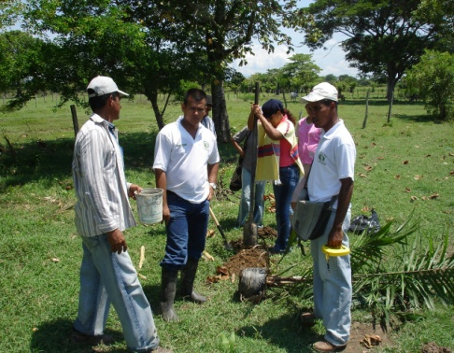
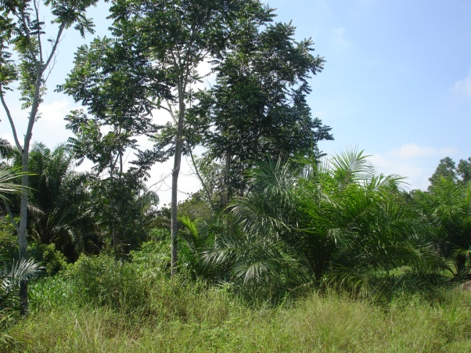
From subsistence to profitability
Tequendama was the first company in Colombia to successfully develop a Productive Alliance scheme in the palm oil industry.
The palm oil crop is compatible with traditional farming.
Price Stability Fund

Slide 19
From subsistence to profitability
The commitment to commercialize smallholders production holds an inherent responsibility.
Possibility that our associates have to access certifications schemes (such as Organic and RSPO) that guarantee market access.
Altogether, Productive Alliances program includes more than 2000
The three association and two cooperatives allied through this program, now have created a social

Slide 20
Milestones 2010
First Sustainability Report: Second version available in June 2011.
RSPO: we took part in the construction of the National Principles and Criteria although we created and certified ourselves through Local P´s and C´s.
Global Environmental Facility Funding: UNDP- Mainstreaming Biodiversity in Palm Cropping in Colombia with an Ecosystem Approach
Carbon Footprint Measurement for Banana Production and Full LCA: Worked with UKAS and Mitzuho Institute of Japan
Global Biomass Fund Grant: Execute CDM project under Dutch Government assistance, including the smallholders and creating the Fairtrade CDM scheme.
POPSI Grant: Under the SOLIDARIDAD Foundation, our smallholders are replicating the RSPO information to the regional context

Slide 21
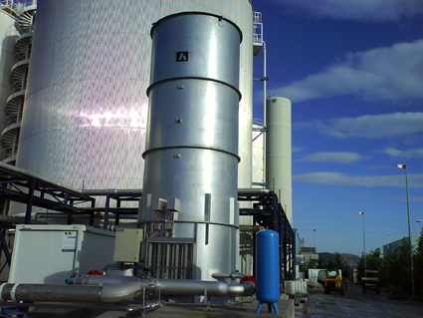
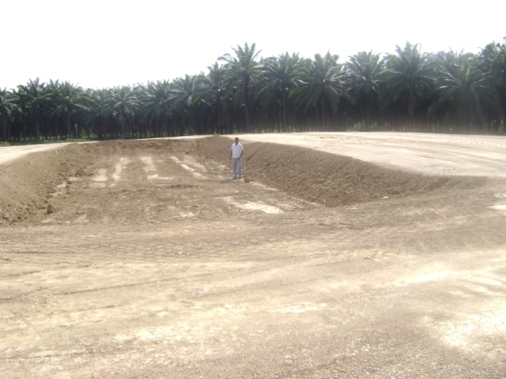
Outlook
Clean Development Mechanism (CDM) Project this system will provide renewable energy to the extraction mill and capture CO₂^{eq.} (March 2011)
Sink identification for Verifecated Emission Reduction´s: Offset administrative emissions
Carbon Neutrality 2012: PAS 2060 UK standard
Zero Waste Company
Environmental Education and Biodiversity Pathways in our farms
Shoe collaboration
Housing Project for our coworkers (100)

Slide 22
Thank You!
FROM THE SOIL TO THE MARKET

