Slide 1
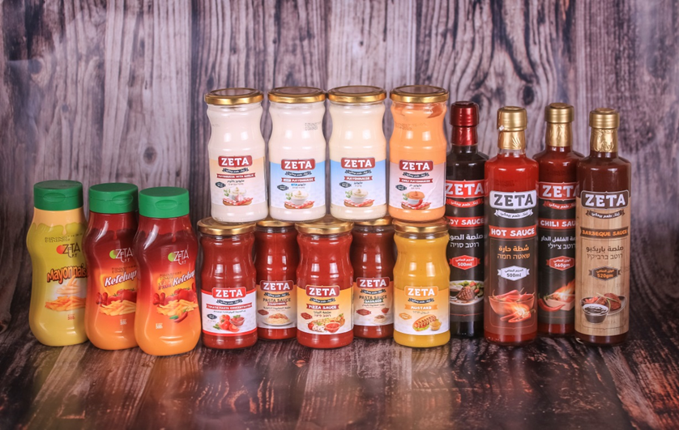
19 - Zeta Foods

