Slide 1
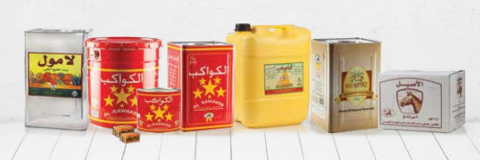
18 - The Vegetable Oil Industries Company (VOIC)

